Slide 1
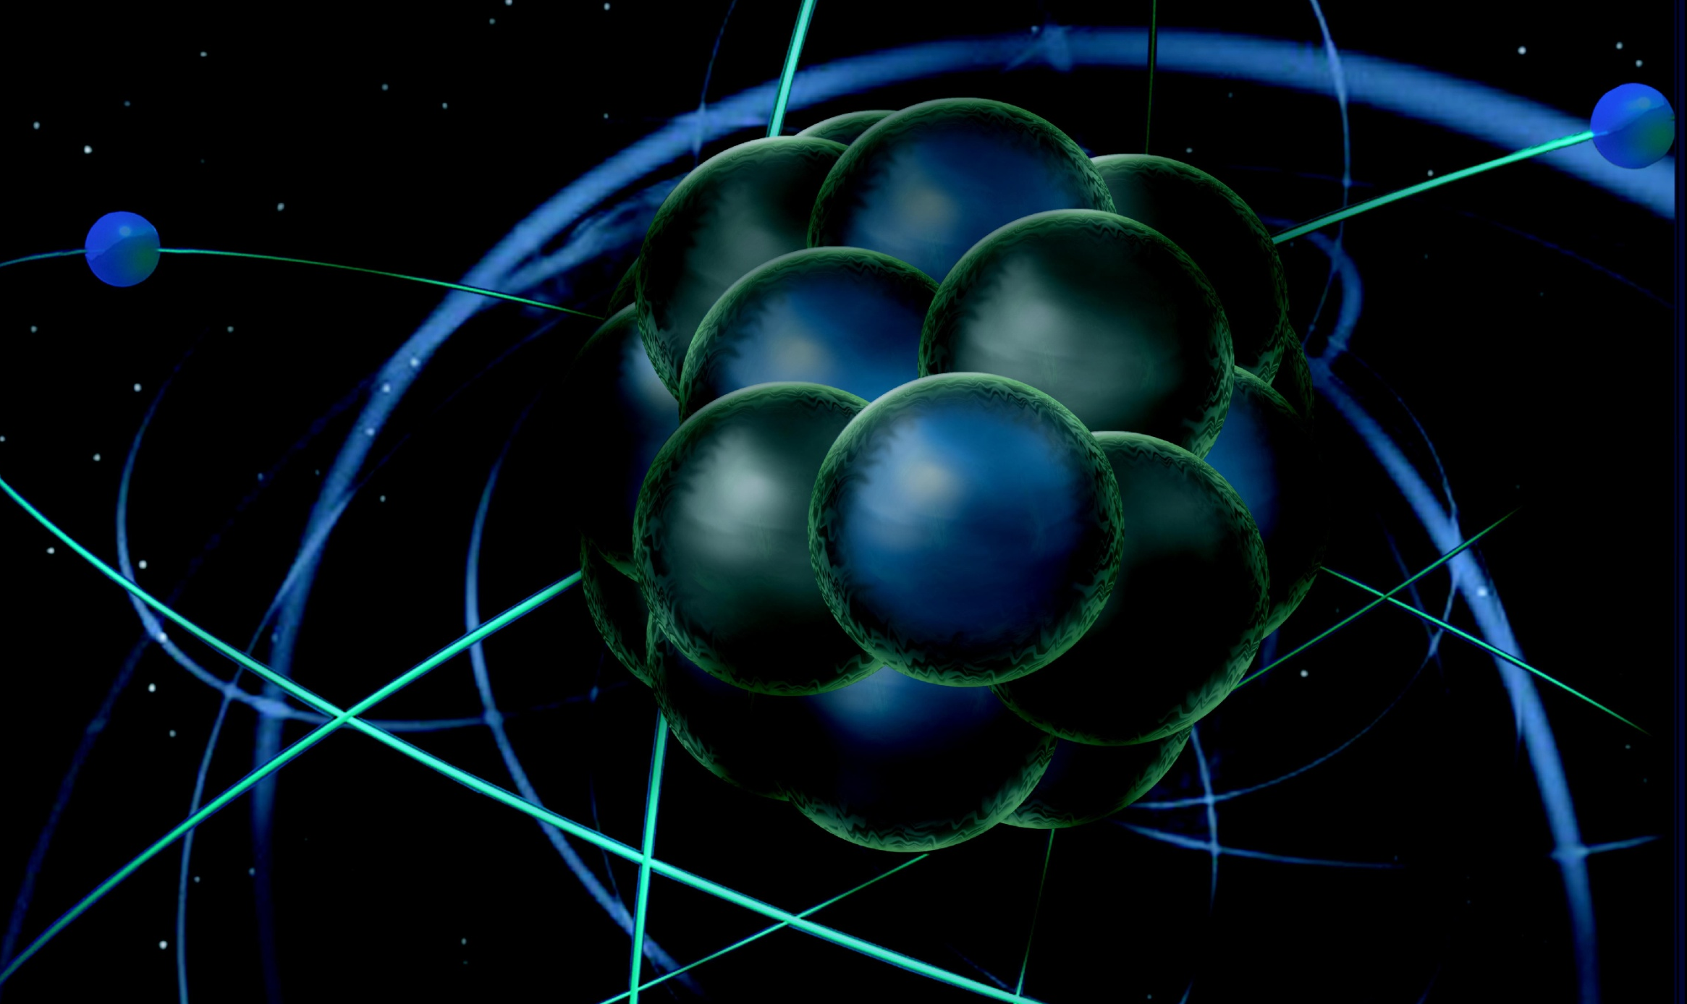
JLab Perspective on Hall A
Request:
news of the lab with a perspective on Hall A.
plans for sustainable multi-hall operations of CEBAF and prospects for full energy capability → I assume Arne will cover, but I will add some perspective on scheduling
recent progress in the JLEIC project and perspectives for realization.
Rolf Ent
Note: I took many slides from Mont/Bob … but gave it my own spin by adding some
Hall A Collaboration Meeting
Jefferson Lab - January 18, 2017

Slide 2
ERR (Experiment Readiness Review) in a Nutshell
If your experiment includes one-of-a-kind equipment with potential novel safety implications (examples are SC magnets, tritium or high-power cryogenic targets) it requires a first-phase ERR for this equipment at the design stage.
If your experiment requires items in the category above and/or equipment beyond the declared base equipment (examples are new detector technologies, new beam lines, new spectrometers), it requires a second-phase ERR before scheduling can be requested. Always check if you need a second-phase ERR well in advance of considering a request for scheduling.
If your experiment only includes base equipment (as declared by the Deputy AD) and only in operation modes already executed, or only additional equipment that is a direct clone of base equipment, it only needs a third-phase ERR.
2

Slide 3
12 GeV Readiness Reviews
Experimental Hall | Project | Date
D | Solenoid Cool down | 11/6/2012
D | Solenoid Power up | 1/9/2013
D | Tagger Magnet | 12/3/2013
D | Cryo Target | 5/8/2014
D | GlueX | 7/1-2/2014
C | Q1 Power up | 1/21/2015
C | HB Power up | 3/25/2015
D | Solenoid Operation | 7/14/2015
B | Torus Cool down (2 reviews) | 4/13/2016 6/27/2016
B | Torus Power up | 7/18/2016
D | L3 trigger* | 7/22/2016
C | SHMS Detectors | 8/24-25/2016
C | Q2/Q3/D Magnets | 10/12/2016
* Not really 12 GeV Equipment transitioning, but closely related to the 12 GeV design for GlueX/hall D
3

Slide 4
Experiment Readiness Reviews
Experimental Hall | Experiment | Date
A | Hall A restart | 12/9/2013
B | HPS | 7/10/2014
A | DVCS/G_{M}^{p} | 9/18/2014
Accelerator | Bubble Chamber Experiment | 8/18/2015
A | Tritium Target Review | 9/15/2015
B | PRad Experiment PRad Experiment 2nd Review | 11/12/2015* 3/25/2016
LERF | DarkLight | 12/7/2015
A | Series of (4) Tritium Experiments | 3/16/2016
A | APEX | 4/7/2016
A | PREX-CREX | 6/1-2/2016*
B | CLAS12 Ancillary Equipment | 6/13-14/2016
D | Primakoff Experiment | 7/20/2016*
A | ⁴⁰Ar Spectral Function | 7/21/2016
C | Series of (7) Initial Experiments | 8/24-25/2016
B | Pre-ops and first commissioning exp. | 12/6-7/2016
+ successful accelerator readiness review phase 4 (B & C) on January 9 + 10, 2017
* Did not pass the Experiment Readiness Review
4

Slide 5
Enhancements beyond 12-GeV Upgrade
• Hall A DVCS Calorimeter (France - Orsay) installed/used/de-installed
• Hall A SBS – WBS1 complete, WBS2 & 3 near-complete (Capital Equipment (CE))
• Hall A SBS GEMs (Italy INFN, UK), Hadron Cal. (CMU+INFN) ongoing (ops)
• Hall A pre-R&D toward PV (MOLLER magnet concept, with MIT) ongoing (ops)
• Hall A SOLID (China, Temple, Duke, ANL, …) ongoing (magnet - CE)
• Hall A APEX septum magnet (Canada, Stony Brook) complete
• Hall B longitudinally polarized target (ODU …, NSF/MRI) ongoing (infrastr. - CE)
• Hall B forward tagger (Italy INFN & NSF/MRI) complete
• Hall B RICH sector(s) (Italy INFN, Chile) near-complete (PMTs, materials - CE)
• Hall B MicroMegas (France - Saclay) near-complete
• Hall B Central Neutron Detector (France - Orsay) complete
• Hall B Heavy Photon Search (HPS) (DOE HEP, France, INFN) complete/in use
• Hall B H Gas Target for Proton Charge Radius (NSF/MRI) used/de-installed
• Hall C Kaon Detection System (CUA …, NSF/MRI) installed
• Hall B,C Backward nucleon detection system (Israel/ODU/MIT) ongoing
• Hall C Neutral-Particle Spectrometer (CUA …/France/UK/Armenia, NSF/MRI) ongoing
• Hall D DIRC-based PID/Cherenkov system (JLab/IU/MIT) ongoing (CE)
• Hall D Discussions with China on calorimeter upgrades planning + CE
• LERF: DarkLight Phase-I Equipment (MIT …, NSF/MRI) ongoing, test completed
• Injector: Bubble Chamber for ¹⁶O(γ,α)¹²C inverse kinematics (ANL) ongoing

Slide 6
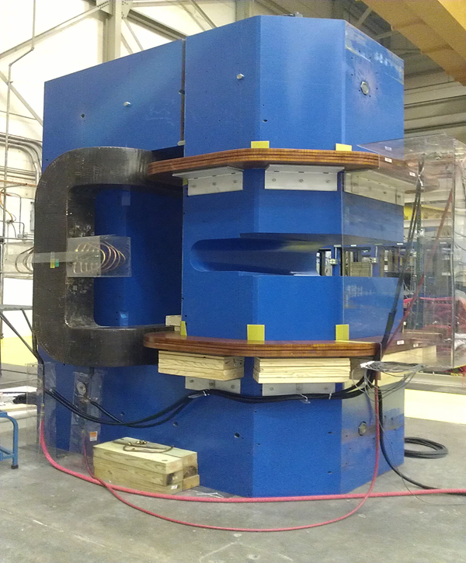
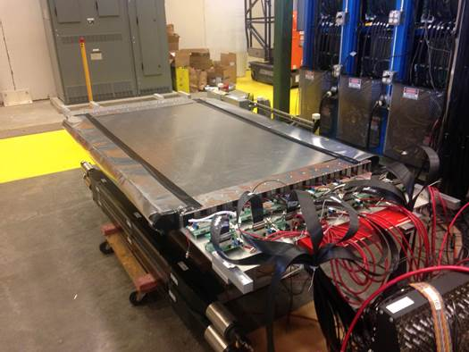
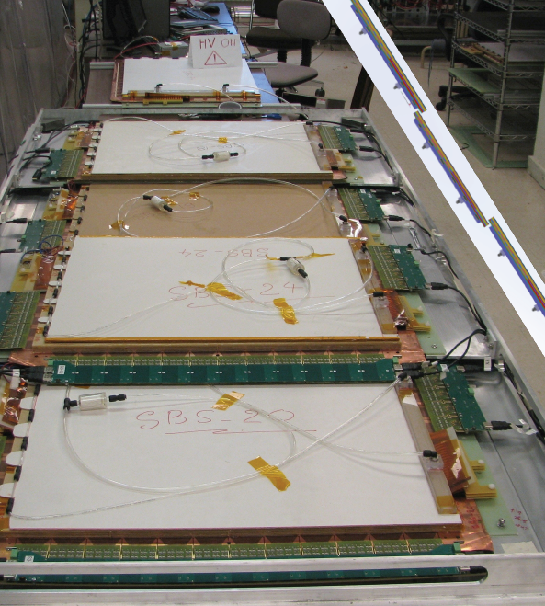
SBS Construction Nearing Completion
Project started Oct 2012 – to be completed Feb 1, 2017
3 major WBS elements and 5 dependencies:
(HCAL (CMU), GEM trackers (INFN), Polarized ³He (UVa&JLab), GRINCH (W&M), ECAL (SBU&JLab))
Successful 4th annual review Nov 2016
Project on track for completion, transition to operations plan likely includes tracking of dependencies
Led by Idaho State U including sci. fiber polishing & assembly
CDET plane assembly and testing led by CNU
Two planes, each 3 modules, completed Aug 2016
All scope on site, to be visually verified by engineers
GEM production near-final at UVa: 39/40 complete (Dec 2016)
Status February 2015: 6/40
All GEM electronics finalized, production at INFN, QA at UVa
WBS1 Completed 01/22/16
WBS2 Coordinate Detector
WBS3 GEMs & Electronics
Notes:
RE updated slide (2/3/2016 email); AL formatting edits 06Feb

Slide 7
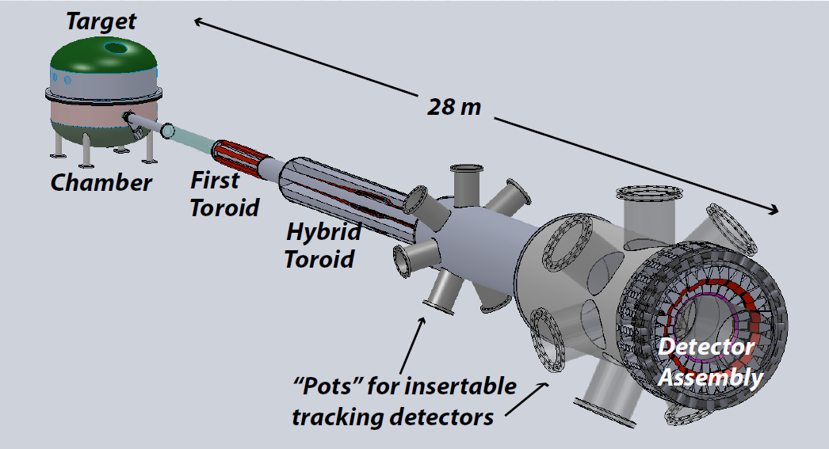
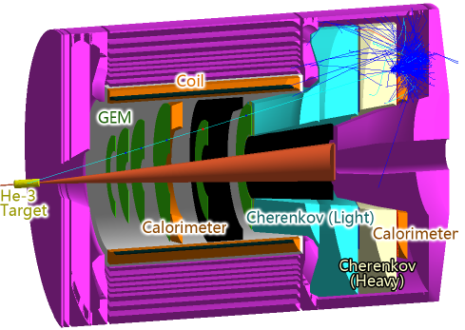
Future Projects
MOLLER experiment
(Possible MIE – FY17-20)
– Standard Model Test
– DOE science review (September 2014) – strong endorsement
– Director’s review held December 15-16, 2016
Technical, cost & schedule
Report due in mid January
– Still hope for FY18 start
SoLID
– CLEO Solenoid 
– Chinese collaboration
– Director’s review (Feb. 2015)
 new pre-CDR almost complete
– Collaboration briefing to DOE-NP
(Nov. 2015)

Slide 8
FY17 Budget
Nominally, first year of full operations in 12 GeV-era and Operations budget should have increased correspondingly.
President’s Budget (NP = $636M) up 3%
JLab Ops up $5.5M; but insufficient for full operation
Major increases in isotope program (+$8M) and RHIC (+$7.5M)
Senate Mark: $636M
Language for FRIB construction and RHIC ops
House Mark: $620M
Language for FRIB construction, RHIC ops, and CEBAF ops
No Federal Budget yet:
Continuing Resolution (CR) until April 28.
Held to FY16 level -
NP $15.4M below Pres. Budget
JLab $5.5M below Pres. Budget
NP=DOE Office of Nuclear Physics

Slide 9
FY17 Planning
Anticipate considerable uncertainty in transition between Administrations
NP additional Ops support?
If a full year CR, NP has substantial shortfall
FY17 @ FY16 CR Budget level:
Major impact on non-labor spending (travel, hardware, contract labor, etc.)
Reduced Weeks of Accelerator Operation:
FY17 @ Pres Budget = 23 weeks
FY17 @ FY16 Level = 16 weeks
Workforce:
New/replacement hires limited to critical needs
In extremis, forced vacations and furloughs would be considered
Reduction in force not anticipated
U.S. has made a major investment in CEBAF. Laboratory has a clear mission, nuclear physics and accelerator technology, which is supported by DOE. We will work to mitigate negative effects of budget constraints on all aspects of the program, especially the workforce.

Slide 10
CEBAF Three-Year Schedule
Nov 2016
Modified Nov. 2016
Feb 2016
Calendar Year
2016
2017
2018
Fiscal Year
2016
2017
2018
Accelerator
Activity
Opportunistic
Physics
Physics
Physics
Beam
Activity
SBS Construction
Hall A
Activity
Opportunistic
Physics
Physics
Physics
Beam
CLAS12 Construction/Installation
Hall B
Activity
Activity
Non-CLAS12 Ops*
Physics
Physics
Beam
Hall C
Activity
SHMS Construction/Installation
Activity
Comm.
Physics
Physics
Beam
Opportunistic
Physics
Physics
Physics
Hall D
Activity
Beam
* PRad Summer 2016 run
Beam for Commissioning
Beam for Physics
Non-CLAS12 Ops
10

Slide 11
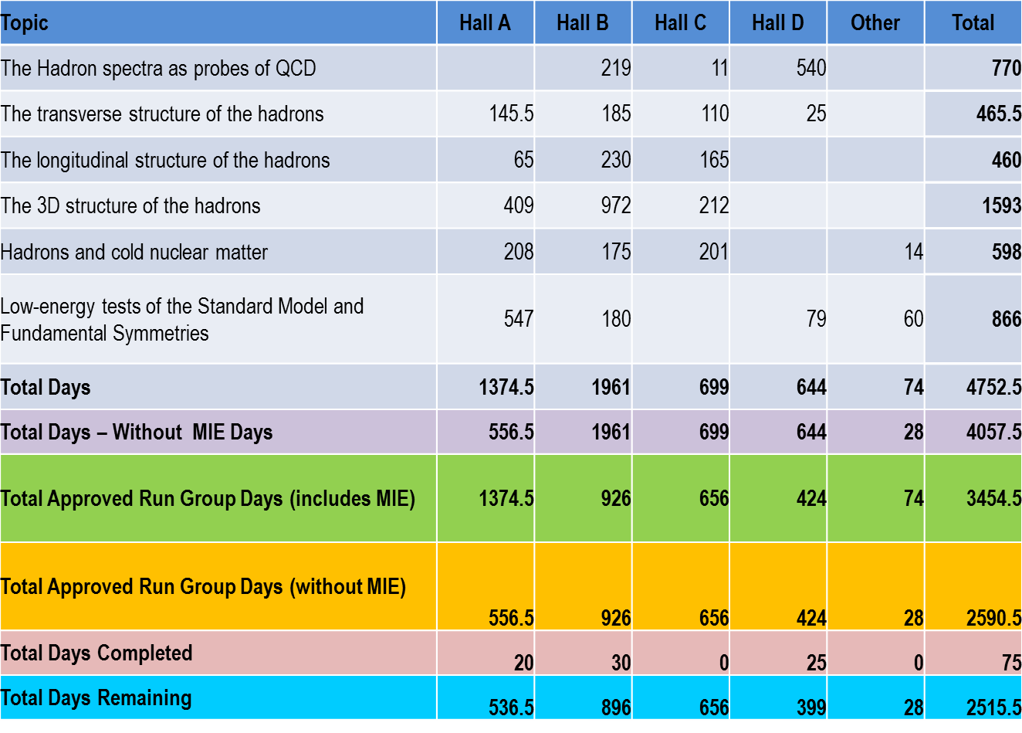
12 GeV Approved Experiments by PAC Days
xx
28
“A Decade of Experiments” – could be 6 or 15+ pending budgets etc.

Slide 12
Priorities Folded into Scheduling
12 GeV Project Priorities
Scientific Priorities – High Impact and/or Timeliness
Funding Agency Commitments such as
DOE/NP Capital Equipment Commitments (SBS, BRICH, DDIRC, etc.)
DOE/HEP Commitment (HPS)
NSF/MRI Funded Equipment (e.g., PRad, Hall C SHMS Detectors, NPS)
International Funded Equipment (e.g., BRICH)
Pragmatic Reasons such as
Safety Issues – ALARA (like use HRS not BigBite with Tritium target experiments, Tritium only one year on site)
Scientific Priorities – Science Rating or Verify Operational Requirements (like new beam requirements, new detector commissioning, etc.)
What is ready and “fits” into schedule
Installation times required
Likelihood to get science results out fast
Impact on Young Scientists and/or PhD Students
Can only run 3 out of 4 Halls together (up to Fall 2018?)
What could run beyond May 6 Power Meter Readout

Slide 13
Operations Constraints – some examples
Halls B and C are gearing up for 12-GeV pre-ops KPP demonstration
→ they must get priority in accelerator operations.
We can run with a Hall multiplicity of 3.0 only, out of 4 Halls, until Accelerator Operations has fully commissioned potential 4-Hall Beam Delivery (Fall 2018)
→ BUT, to get to a Hall multiplicity of 3.0 with a versatile and reliable machine will take some effort → see Arne’s talk
In Hall A, we plan to bring the closed 3H target cell on site for a full-year series of experiments on 3H. The plan is to return the 3H after one year to Sandia. This restricted duration puts pressure on the series of 3H experiments scheduled (they require 74 PAC days – exactly 23 weeks), especially with a long CR
→ Had to delay as we could only do a limited run this Spring
Hall compatibility. E.g., the precision longitudinal-transverse separated cross section science program in Hall C often requires periods of changed linac energy settings, sometimes but not always compatible with the programs in other Halls
→ not a direct issue for 2017 given the schedule change, but relevant for 2018
+ Cryogenics, polarization constraints, labor availability, facilities improvements, etc.
13

Slide 14
2015 NSAC Long Range Plan
RECOMMENDATION I
The progress achieved under the guidance of the 2007 Long Range Plan has reinforced U.S. world leadership in nuclear science. The highest priority in this 2015 Plan is to capitalize on the investments made.
· Operate 12 GeV CEBAF
RECOMMENDATION II
We recommend the timely development and deployment of a U.S.-led ton-scale neutrinoless double beta decay experiment.
RECOMMENDATION III
We recommend a high-energy high-luminosity polarized EIC as the highest priority for new facility construction following the completion of FRIB.
· Jefferson Lab EIC (JLEIC) development
RECOMMENDATION IV
We recommend increasing investment in small-scale and mid-scale projects and initiatives that enable forefront research at universities and laboratories.
· MOLLER, SoLID

Slide 15
EIC Developments
EIC User meeting at ANL July 7-10, 2016
UG charter, elections (IB chair – Christine Aidala)
2017 EIC UG Meeting in Trieste, Italy
DOE-NP will increase EIC accel. R&D in FY17
– Through ‘tax’ on JLab/BNL
– Peer review held for November 29-December 2
- report to be released in mid January
National Academies Study, Chair Gordon Baym, University of Illinois, Urbana Champaign, first meeting projected for January 2017.

Slide 16
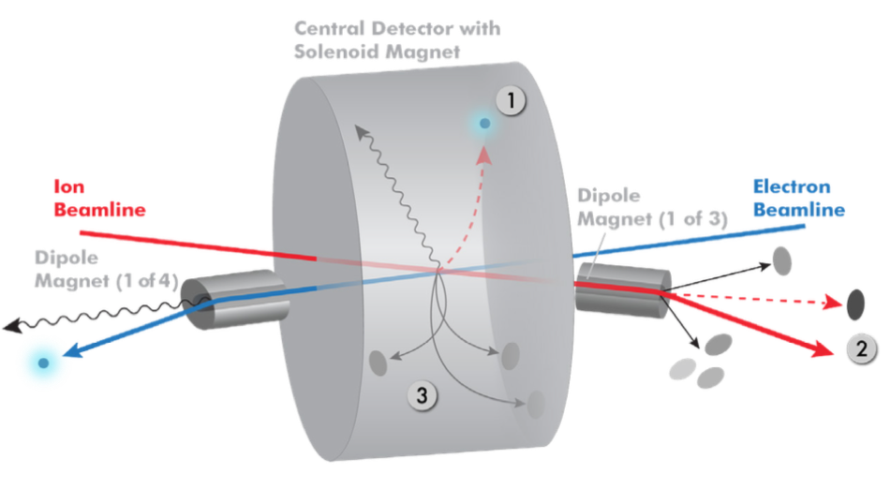
Integration IR: JLEIC total acceptance detector
Possible to get ~100% acceptance for the whole event
Scattered electron
Particles associated with struck parton
Particles Associated with Initial Ion
Relatively large crossing angle (50 mr) combined with large aperture final focus magnets,
and forward dipoles are keys to this design.

Slide 17
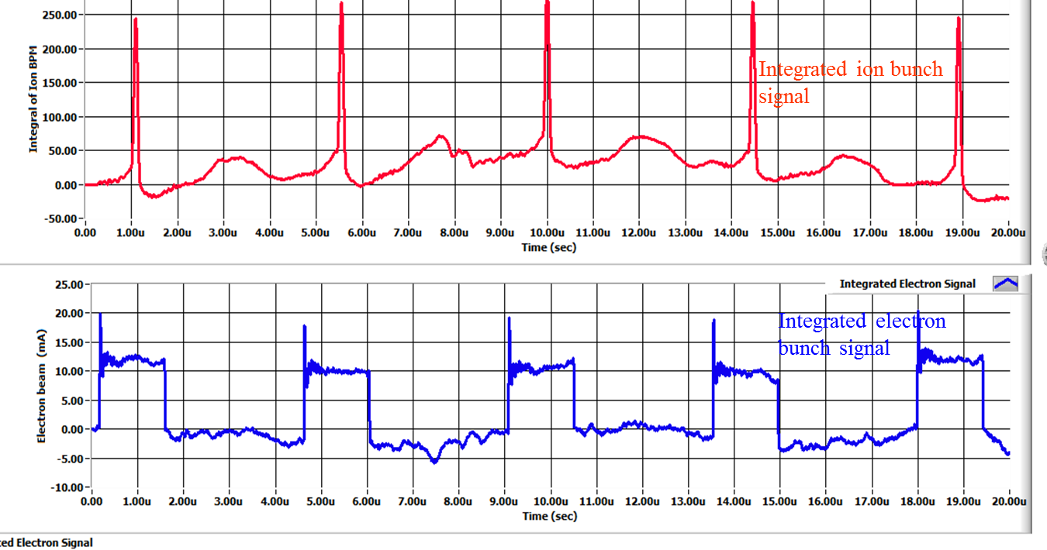
Bunched Ion Beam Cooling – preliminary results
A collaboration of JLAB and Institute of Modern Physics (IMP), China
The 1st experiment was carried out on May 17-22, 2016, at Lanzhou, China
A 7MeV/u ¹²C⁶⁺ ion beam stored in the IMP CSRm ring, either coasting or captured by 450kHz RF system (two long bunches)
Cooling of both coasting and bunched ion by a pulsed electron beam are observed: first successful step of experimental demonstration of bunched beam cooling
Data analysis both at IMP and JLAB is in progress
Initial 1D modeling with RF capture and bunching shows the ion cooling and synchrotron sideband effects, agree with experimental observations
Experiment data observation on BPMs
cooled ion bunches
uncooled ion bunches
Electron bunches 1.5μs

Slide 18
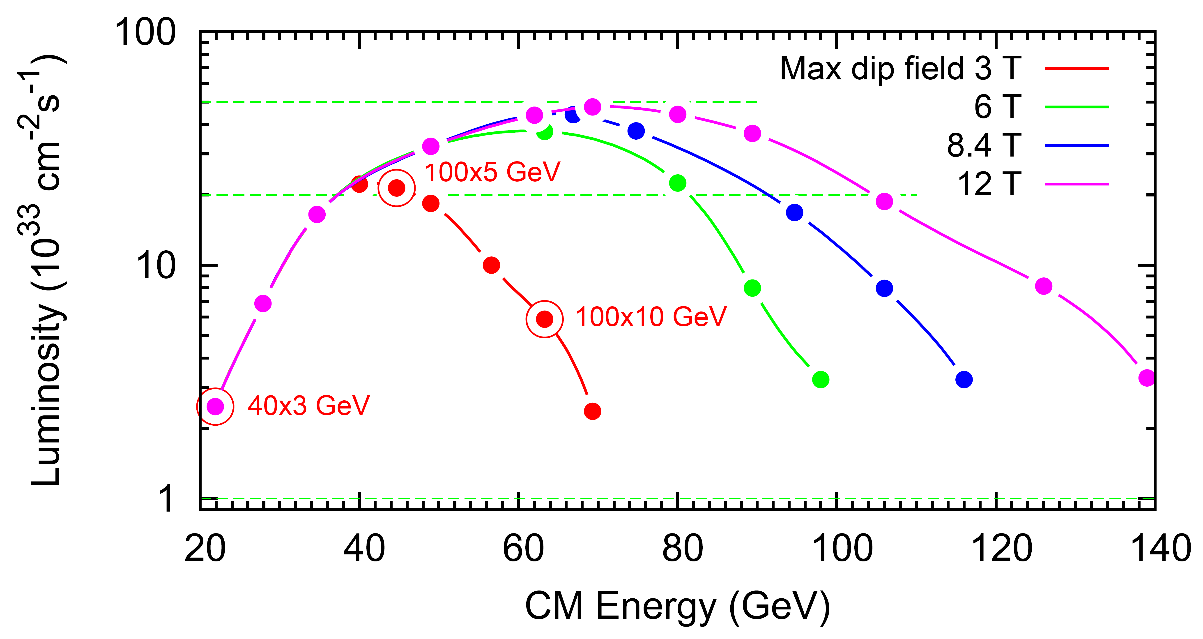
JLEIC energy reach and luminosity
Just implemented a baseline modification (essentially: add strong cooling back in and optimize collider parameters, but no change of concept)
Baseline = 3T
Note: Baseline choice is a mix of risk, total detection capabilities, energy/luminosity needs. Baseline gives access to start all science of EIC white paper.

Slide 19
JLEIC possible timeline (eRHIC similar)
Activity Name | 2010 | 2011 | 2012 | 2013 | 2014 | 2015 | 2016 | 2017 | 2018 | 2019 | 2020 | 2021 | 2022 | 2023 | 2024 | 2025
12 GeV Operations
12 GeV Upgrade
FRIB
EIC Physics Case
NSAC LRP
NAS Study
CD0
EIC Design, R&D Pre-CDR, CDR
CD1(Down-select)
CD2/CD3
EIC Construction
pre-project
on-project
Pre-CDR
CDR
CD0 = DOE “Mission Need” statement; CD1 = design choice and site selection
CD2/CD3 = establish project baseline cost and schedule update: 1/13/17

Slide 20
Director’s Perspective
Emphases
Core Nuclear Physics
Finish the upgrade project, safely, on time, and within budget.
Full-time operations. Operations budgets continue to be a concern here.
Reliability and Risk Mitigation
Advance new NP projects beyond the upgrade
Develop Jefferson Lab EIC design:
Technical Designs, Collaboration, (Land now secured)
Technology Collaborations
Large projects, like FRIB and LCLS-II, within context of a Nuclear Physics program – management is key
Management/Personnel
Operations Functions: Facilities, Procurement, Financial Management, Budget Office, Human Resources, Information Technology, Legal, ES&H are vital to the functioning of the lab
What the lab can achieve depends on your efforts, Jefferson Lab successes will be your successes.
Jefferson Lab world- leading Nuclear Physics

Slide 21
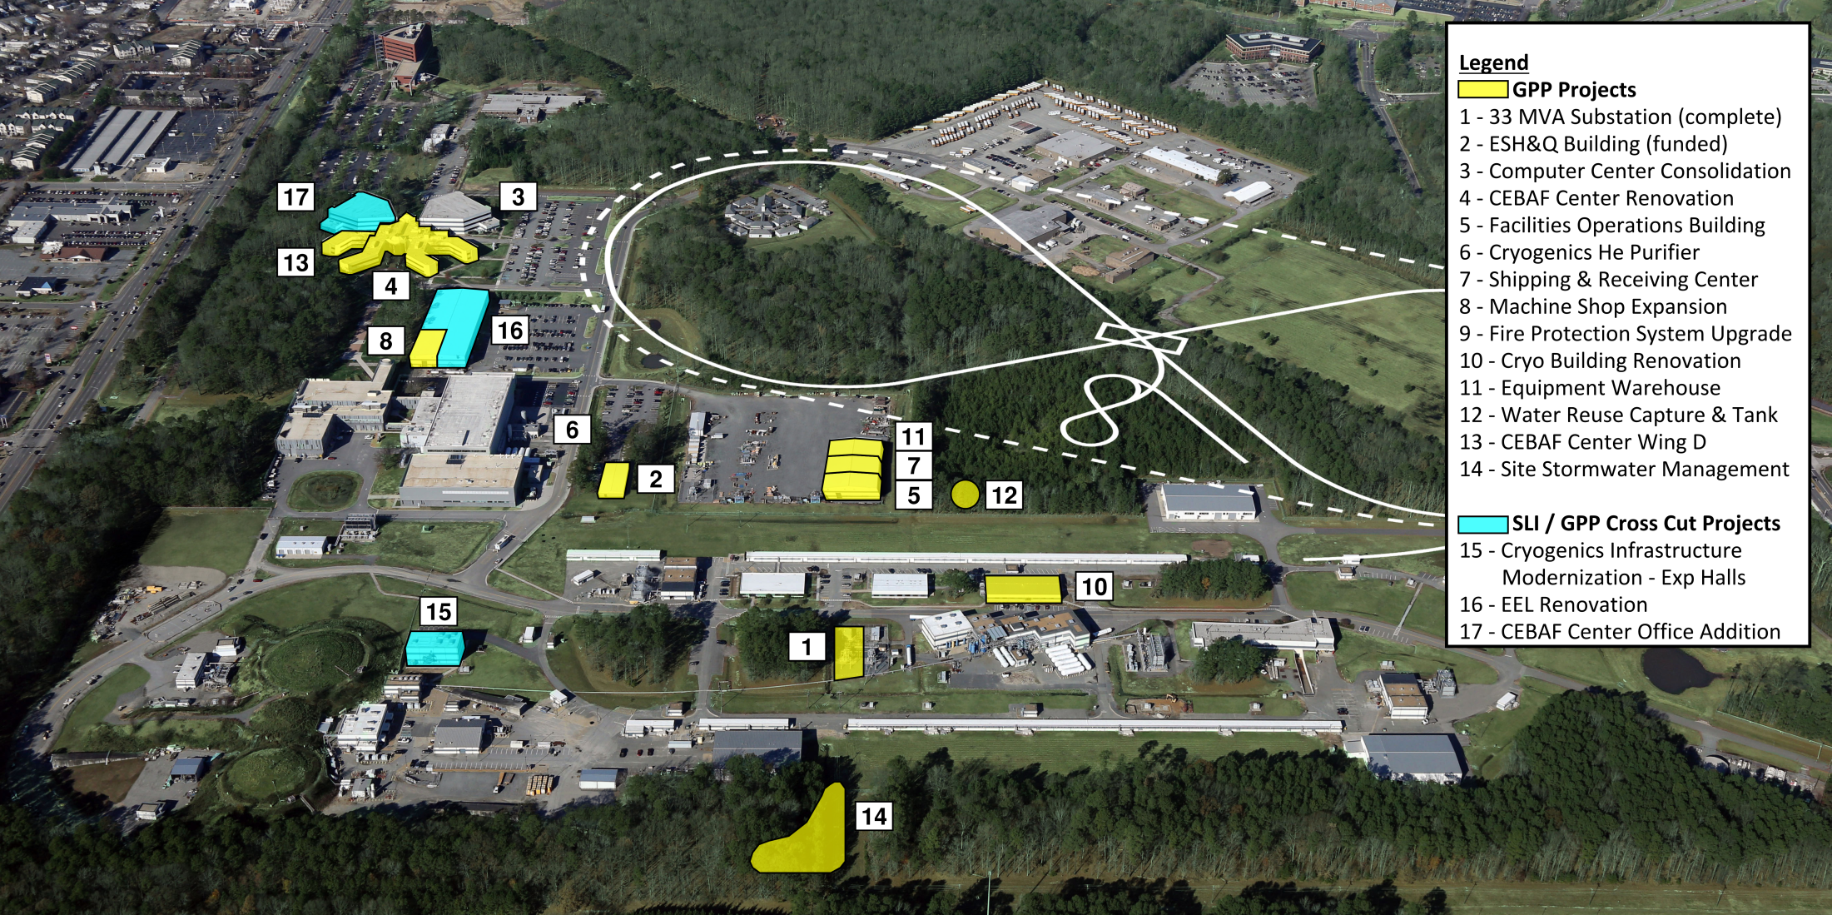
Jefferson Lab 2025 Campus Plan
We appreciate your support of the multiple traffic pattern changes.
We see the Hogan Road changes as a definite improvement to our access.

